Slide 1
Project 1: Florida Accessibility Code for Building Construction Review and Recommendations
Presented to the
Florida Building Commission
Accessibility Technical Advisory Committee
State of Florida Department of Business and Professional Regulation
June 24th, 2015
David O. Prevatt, Ph.D., P.E. (MA)
James Terry, AIA, Evans Terry Associates (Consultant)
Janet Fay, Graduate Assistant

Slide 2
Project Scope
Perform literature review of recent scholarly work on the ADA and its impacts in Florida
Evaluate and summarize impact of the law on building construction and on the general public
Interpret/explain results and implications and determine whether any action is needed by FBC
Develop a technical basis for Florida-specific ADA items

Slide 3
UF’s Process
Researched statistical data on population to compare demographics of US to Florida
Retained ADA Consultant Evan Terry Associates (ETA) for professional opinion on rationale for Florida-specific items
Reviewed the literature on accessibility laws in Florida, other states and at Federal level
Assess pros/cons of Florida-specific accessbility items
Determine a technical basis for each item
Recommend to FBC for each Florida specific item, with the help of ETA

Slide 4
Americans with Disabilities Act Standards
The Americans with Disabilities Act of 1990 (ADA) prohibits discrimination and ensures equal opportunity for persons with disabilities in employment, State and local government services, public accommodations, commercial facilities, and transportation.
ADA Standards for design first adopted in 1991
Most recent revision 2010 →effective March 2012

Slide 5
Florida Accessibility Code for Building Construction (FACBC)
In 1993 Florida Legislature enacted the "Florida Americans with Disability Accessibility Implementation Act”
Incorporates ADA requirements into Florida law
Maintained existing provisions of Florida law that were considered more stringent than ADA guidelines
Integrated accessibility requirements into the Florida Building Code
Most recent revision was in 2012
Made to be consistent with updated 2010 ADA Standards
Notes:
Is this Florida legislattre? If so, say so
What is ADA requirements? - is the Federal requreiments?
What is more stringent? Also includes? What also includes? Need more precision in the language
What is integrated? What chapter of the code?
Most recent revision of what? FL or Fed? There was a revision on the previous slide in 2012 – is that the same as this?

Slide 6
Florida Population Statistics
As of 2012: 19 million people reside in Florida
13% are disabled; (ranked #19 of 51): 2.45 million
18% are age 65 or older; (ranked #1of 51): 3.5 million
U.S. population age 65 and older will double by 2050
In 2013 Florida received over 90 million visitors
17% of the total state revenue from tourism industry

Slide 7
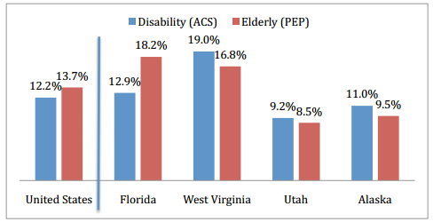
Florida Population Statistics cont’d

Slide 8
Breakdown of Florida’s Disabled Population
Type of Disability | Population 5 yrs and older | Percentage of Total Disability | Definition
Hearing Difficulty | 700,000 | 28.5% | Deaf or serious difficulty hearing
Vision Difficulty | 432,000 | 17.6% | Blind or having serious difficulty seeing
Cognitive Difficulty | 920,000 | 37.5% | Remembering, concentrating, or making decisions because of a physical, mental, or emotional problem
Ambulatory Difficulty | 1,360,000 | 55.2% | Walking or climbing stairs
Self-Care Disability | 520,000 | 21.1% | Bathing or dressing
Independent Living Difficulty | 918,000 | 37.4% | Doing errands alone because of a physical, mental, or emotional problem
Total with Disability | 2,450,000
American Community Survey 2012

Slide 9
Literature Review
Read various publications on accessibility laws in Florida, other states and at Federal level
Includes publications by AARP, Disability Rights Education and Defense Fund, and US Access Board
Examples:
“Aging in Place: A State Survey of Livability Policies and Practices” examines the need for accessibility features in residential structures.

Slide 10
Literature Review
Examples cont’d:
ADA Accessibility Guidelines explains the parking space width required for lift users as well as the force required to open exterior doors.
“Beds in Accessible Sleeping Rooms” gives a technical basis for the clear space needed for mechanical lift devices in hotel rooms.
“Transportation Cost and Benefit Analysis II – Parking Costs” reports on the current prices for building and maintaining parking facilities.

Slide 11
UF’s Recommendations
Following the literature review and demographics assessment, UF made recommendations for each of the Florida specific items
Either reduced, expanded, or no changes necessary
Summary of recommendations found in Appendix 8.1
Notes:
What is this? Need a transition slide. Explain what no change means…. Give an example of one or other – say your parking space drawing - or lavatory… what does this mean?

Slide 12
Items Not Needing to be Changed
12 of the 21 FL Specific Items do not need to be revised by the FBC
Examples:
Access aisle width should remain 44” min.
Wheelchair accessible toilet compartments should contain a lavatory within it
The opening force of exterior hinged doors and/or gates should not to exceed 8.5 lb

Slide 13
Items Needing Change in Code Language
Doors - FL Statute 553.504(3)
Change to say “exterior hinged doors must be designed, constructed, and maintained so that such doors...”
Vertical Accessibility – FL Statute 553.509
Revise wording in statue 553.509(1)(b) to clarify what is meant by “unoccupiable spaces”
Vertical access requirement of 553.509(1)(c) should be made at least equivalent to the ADA standards

Slide 14
Items Needing to be Reduced
Barriers – FL Statute 553.504(6)
Existing exits should be exempt from the requirements to provide accessibility
OR the FACBC should specify that the barrier removal at common emergency exits and entrances requirement is subject to the readily achievable obligation limitation
Define “business establishments conducting business with the general public”
Notes:
This slide is unclear as to its point…
Is this a modification? We cannot understand this change by just reading this?

Slide 15
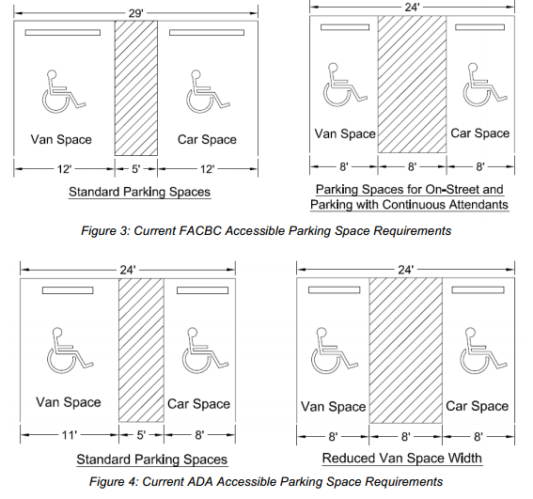
Items Needing to be Reduced cont’d
Parking Spaces – FL Statute 553.5041(5)(c)1
Require 9’-0” wide car spaces and require one van space that is 12’-0” wide for every accessible spaces
Florida have a tiered accessible parking permit system, where people who do not need an access aisle or have a van accessible decal cannot park in the van accessible spaces
Notes:
Add your sketch
What does the second bullet mean?

Slide 16
Items Needing to be Expanded
Hotels, Motels, and Condominium Features – FL Statute 553.504(4)
Require open-frame beds to be provided in the fully accessible mobility feature guest rooms (as well as the rooms with additional accessible features)
Specify the minimum clear height under the bed
California has 7” min. clearance requirement

Slide 17
Items Needing to be Expanded cont’d
Parking Spaces –553.5041(4)(a)&(b)
Adopt on-street parking scoping standards at least equivalent to the upcoming or the Proposed Public Right-of-Way (PROW) Guidelines
Change FACBC Sections 208.2.5.1 and 208.2.5.2 to read “There must be a minimum of one accessible parking space …”
Notes:
What is PROW – first use of term – spell out
Second bullet – changed from what was there previously?

Slide 18
Items Needing to be Expanded cont’d
Items Needing to be Expanded cont’d
Parking Spaces – FL Statute 553.5041(5)(d)
Specify a maximum curb height
FDOT standard details assume 6” curb
Mirror the adopted or Proposed PROW Guidelines in R309
Removing Parking Barriers – FL Statute 553.5041(5)(e) 1&2
Clarify that the exemption for pre-1991 facilities is not a limitation on the obligation to provide program access by public entities or for places of public accommodation to perform readily achievable barrier removal
Notes:
What is a recommended curb height? What curb height are other states that have done this?

Slide 19
Items Needing to be Expanded cont’d
Items Needing to be Expanded cont’d
Vertical Clearance for Vehicles – FL Statute 553.511
Provide some fully compliant spaces at an alternative location as well as some partially compliant spaces on the shortest accessible route when providing all fully compliant accessible spaces on the shortest accessible route is technically infeasible or not readily achievable
Notes:
What is a recommended curb height? What curb height are other states that have done this?

Slide 20
Summary
UF has provided the FBC with an assessment and recommendations for the 21 Florida specific items of the FACBC
Code language of other states with similar requirements to Florida found in Appendix 8.2
ETA has given a list of questions to be considered when developing accessibility standards, found in Appendix 8.4

Slide 21
Summary
Please note that the University of Florida has given recommendations based on data available online and from the knowledge and resources of the ADA contractor. This is a technical study of a politically driven issue so the views of specific contractors and disability organizations were not taken into consideration.

Slide 22
Thank you!
Questions/Comments

